Slide 1


Pairwise sequence alignment
Paweł Dąbrowski-Tumański
MiNI Lecture, Fall 2025

Slide 2


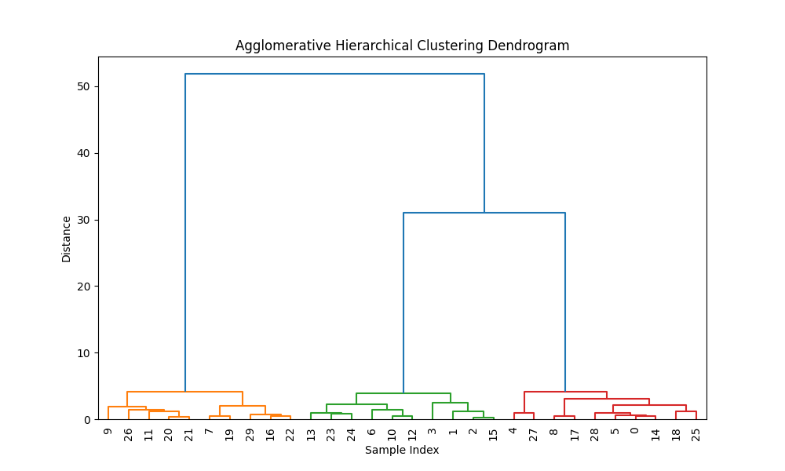




Intro
📏 Dendrogram and clustering depends on the metric
📏 What is the distance between two sequences?

Slide 3
Intro
MGSSHHHHHHSSGLVPRGSHMSLKHFLNTQDWSRAELDALLTQA
MHHHHHHSSGVDLGTENLYFQSNAMAFNLRNRNFLKLLDFSTKE
--------------------------------------------
ALFKRNKLGSELKGKSIALVFFNPSMRTRTSFELGAFQLGGHAV
IQFLIDLSADLKKAKYAGTEQKKLLGKNIALIFEKASTRTRCAF
--------------------------------------------
VLQPGKDAWPIEFNLGTVMDGDTEEHIAEVARVLGRYVDLIGVR
EVAAFDQGAQVTYIGPSGSQIGDKESMKDTARVLGRMYDGIQYR
--------------------------------------------
AFPKFVDWSKDREDQVLKSFAKYSPVPVINMETITHPCQELAHA
GFGQAIVEELGAFAGVPVWNGLTDEFHPTQILADFLTMLEHSQP
…

Slide 4
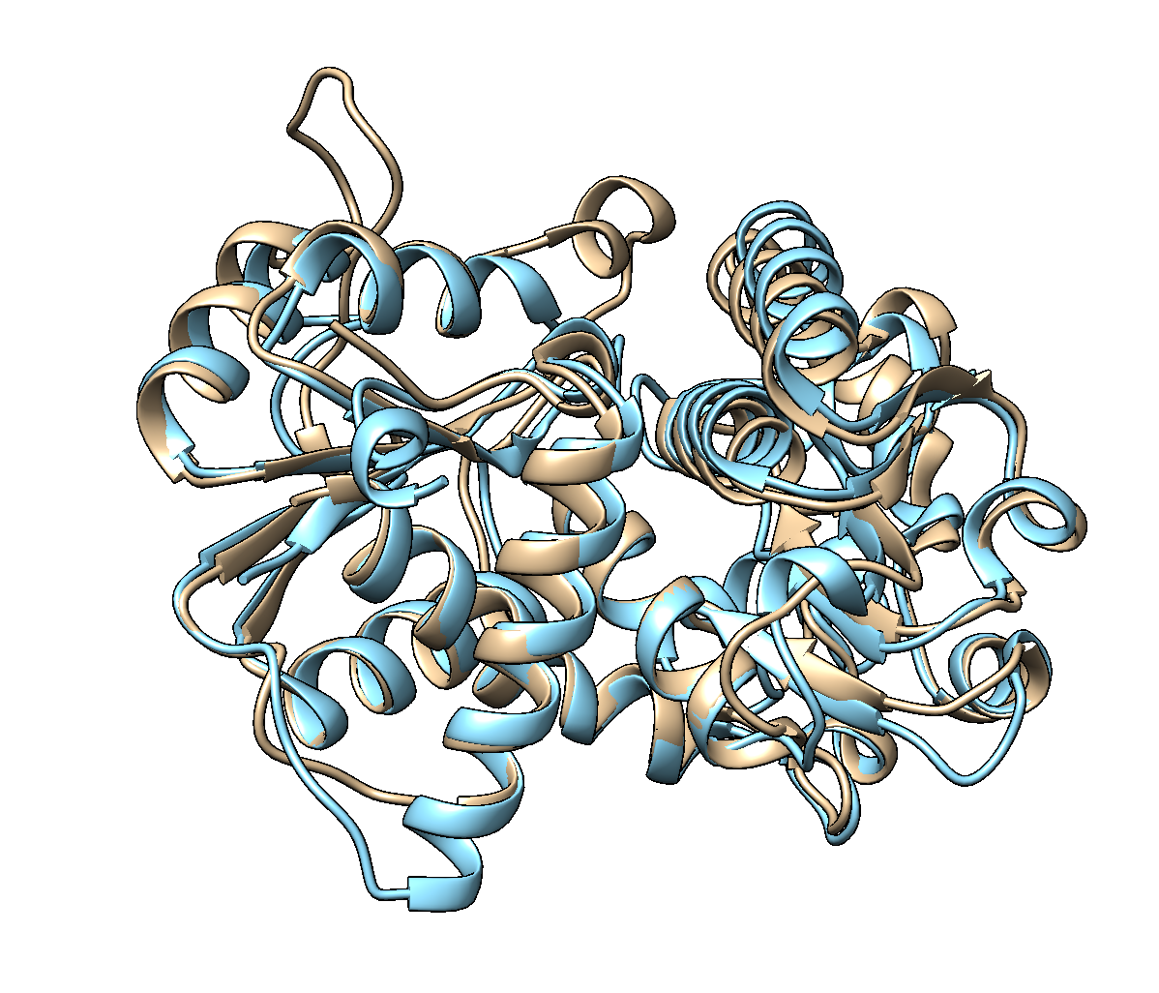
Intro
🧬 ~30% of „sequence identity”

Slide 5
Intro
Feature | Hamming Distance | Levenshtein Distance | Damerau–Levenshtein Distance
Handles substitutions | ✅ Yes | ✅ Yes | ✅ Yes
Handles insertions/deletions | ❌ No | ✅ Yes | ✅ Yes
Handles transpositions | ❌ No | ❌ No | ✅ Yes
Requires equal string length | ✅ Yes | ❌ No | ❌ No
Counts number of edits | ❌ Only mismatches | ✅ All edits | ✅ All edits including swaps
Treats all edits equally | ✅ Yes | ✅ Yes | ✅ Yes
Detects local similarity | ❌ No | ❌ No | ❌ No

Slide 6
Intro
🧬 Handle substitutions differently
🧮 Score alignments quantitatively
➕ Handle insertions and deletions
❗ Differentiate biologically relevant vs random similarity
🔗 Support local and global similarity
🧪 Handle variable sequence lengths
📊 Incorporate evolutionary information
⚡ Efficient computation

Slide 7


Protein vs Nucleic Acids
Feature | Nucleic Acids 🧬 | Proteins 🧪
Alphabet size | 4 letters (A, C, G, T/U) | 20 amino acids
Substitution variability | 🔹 Limited; simple match/mismatch | 🔸 Highly variable; use PAM/BLOSUM
Biochemical similarity | ⚪ Less relevant | 🟢 Important; chemical properties matter
Gap penalties | ➖ Often uniform or linear | ➕ Often affine (gap opening vs extension)
Evolutionary divergence | ⏳ Usually smaller; substitutions predictable | 🕰 Can diverge extensively; scoring matrices required
Local vs global alignment | 🌐 Often global sufficient | 🔍 Local alignment often needed for conserved motifs
Sensitivity to mismatches | ⚪ Less sensitive; all mismatches similar | 🟢 More sensitive; some mismatches tolerated

Slide 8
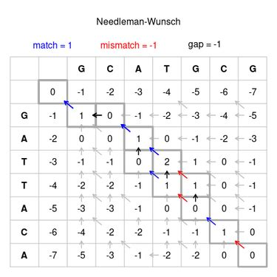
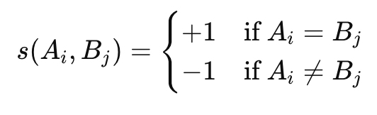
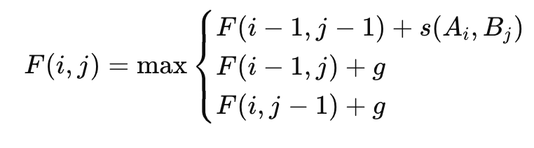
Needleman–Wunsch
📏 Final alignment:
GCAT-GCG
G-ATTACA

Slide 9
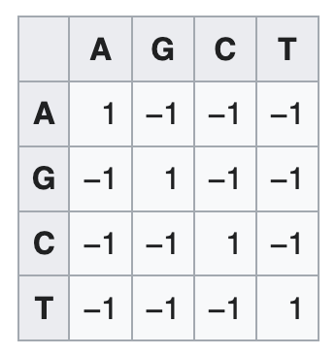
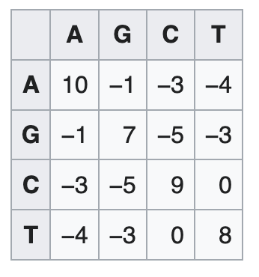
Needleman–Wunsch – Similarity matrix
➕ Scoring matrices allow calcutating the score for each alignment (see optimal path)

Slide 10
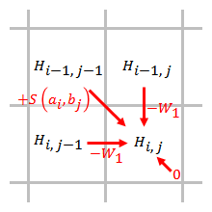
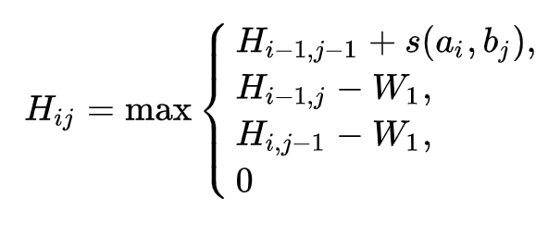
Smith-Waterman Algorithm
🎯 Idea: local alignment of subsequences

Slide 11
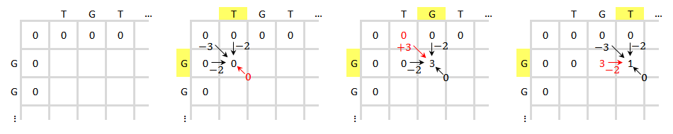
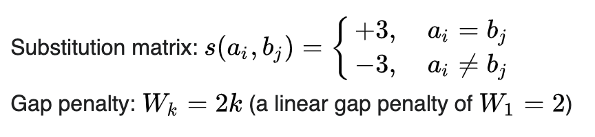
Smith-Waterman Algorithm
TGTTACGG vs GGTTGACTA

Slide 12
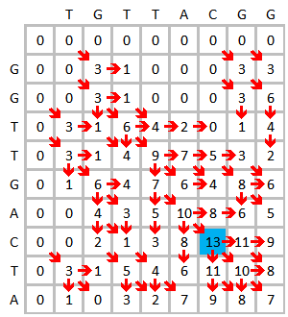
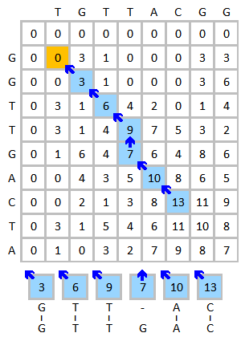
Smith-Waterman Algorithm
(T)G T T - A C(G G)
(-)G T T G A C(T A)

Slide 13
N-W vs S-W
Feature | 🧩 Needleman–Wunsch (NW) | 🧬 Smith–Waterman (SW)
🌍 Type of alignment | Global — aligns entire sequences | Local — aligns best matching subsequences
📈 Goal | Maximize overall alignment score for full length | Find highest-scoring local region
🧮 Recurrence relation | (F(i,j) = \max(F(i-1,j-1)+s, F(i-1,j)+g, F(i,j-1)+g)) | (F(i,j) = \max(0, F(i-1,j-1)+s, F(i-1,j)+g, F(i,j-1)+g))
🔢 Initialization | First row/column = cumulative gap penalties | First row/column = 0 (no forced alignment)
🔗 Traceback start | Bottom-right cell (full alignment) | Cell with highest score (local region)
🧭 Traceback stop | Top-left cell | First cell with 0 score
🧠 Locality | Global — includes entire sequence | Local — only the best matching region

Slide 14
N-W vs S-W
Feature | 🧩 Needleman–Wunsch (NW) | 🧬 Smith–Waterman (SW)
⚖️ Gap penalties | Linear or affine | Linear or affine
🧱 Substitution scoring | Simple or matrix-based (PAM/BLOSUM) | Same — identical scoring model
🕒 Time complexity | O(n × m) | O(n × m)
💾 Space complexity | O(n × m) | O(n × m)
🧮 Score range | Can be negative | Never negative (0 floor)
🧪 Best for | Highly similar sequences of similar length | Distantly related sequences with conserved regions
⚙️ Example use | Aligning orthologs or complete genes | Detecting motifs or functional domains
🧰 Implementation for | Global alignment tools (e.g., ClustalW) | Local alignment tools (e.g., BLAST)

Slide 15
Biological reasoning
❓ Class question: Would all mismatches be equally bad in proteins?
🔄 Similarity reflects chemical and evolutionary interchangeability
🧪 Some amino acid substitutions are more likely than others

Slide 16
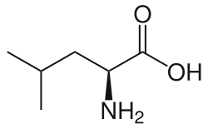
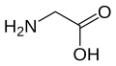
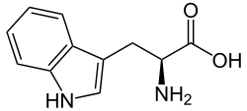
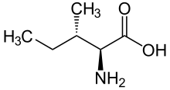
Biological reasoning
🟢 Leucine ↔ Isoleucine = small penalty
🔴 Tryptophan ↔ Glycine = big penalty

Slide 17
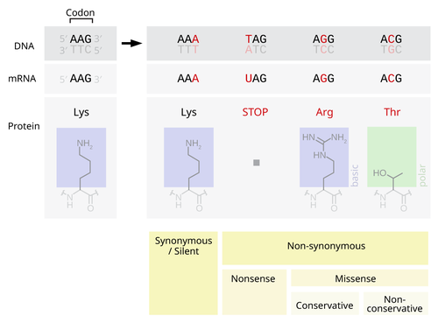

Substitution matrices

Slide 18
Point Accepted Mutation Matrices
🔹 Collect homologous protein sequences
🧩 Generate accurate multiple alignments
🔍 Count accepted point mutations
📊 Compute substitution frequencies
🔢 Normalize frequencies to mutation probability

Slide 19
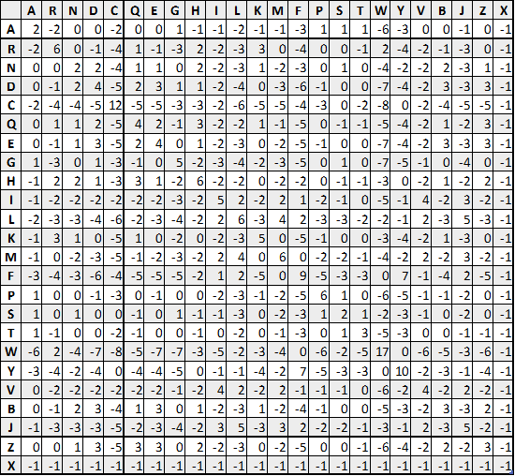
PAM250
⏱ PAM250 represents 250% evolutionary change
🧮 Matrix extrapolated using matrix powering: PAM_n = (PAM1)^n
📊 Low PAM: closely related, High PAM: distant sequences

Slide 20
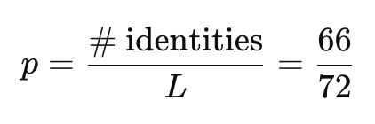
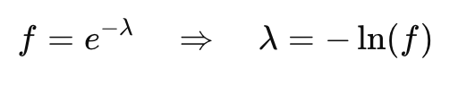
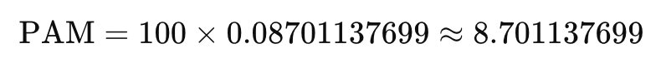
PAM vs evolution
MKTLLILALLAVALAGVQAAPQARQGKELKPLERLQKIEQLEQKQVE
MKTLVILALLAVALAGVQAAPQ-SQGKELKPLDRLQKIEQLEQKQIE
-----------------------------------------------
VIKDLTNVVSTGQIVLPEIQYQIKD
VIKDLTNVVSTGQIVLPEVQYQIKD

Slide 21
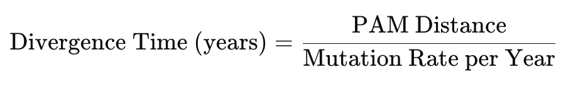
PAM vs evolution
Organism Type | Mutation Rate Estimate (per nucleotide per year) | Source
Humans | ~1.2 × 10⁻⁸ | Crabtree, 2013
Staphylococcus aureus | ~1 × 10⁻¹⁰ | Nature, 2007
Escherichia coli | ~1 × 10⁻⁸ to 1 × 10⁻⁹ | ScienceDirect
Paramecium tetraurelia | ~2 × 10⁻¹¹ | PNAS, 2012
HIV-1 (RNA virus) | ~1.2 × 10⁻⁵ per site per day | PNAS, 2016

Slide 22
BLOcks of Substitution Matrix
🔹 Collect conserved protein blocks
🧩 Cluster sequences by identity threshold
🔍 Count amino acid substitutions
📊 Compute substitution frequencies
🧮 Calculate log-odds scores

Slide 23
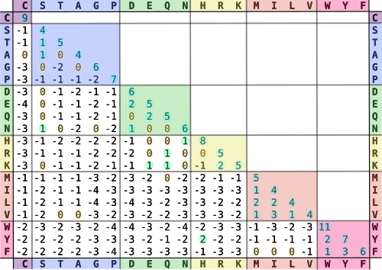
BLOSUM62

Slide 24
PAM vs BLOSUM
Feature | 🧬 PAM | 🧪 BLOSUM
🔹 Basis | Global alignments of closely related proteins | Local conserved blocks (no gaps) from multiple protein families
⏱ Evolutionary model | Extrapolated over evolutionary time using PAM1 → PAMn | Directly derived from observed substitutions; no extrapolation
🧮 Substitution probabilities | Calculated from accepted point mutations per 100 residues | Calculated from observed frequencies in sequence clusters
🔢 Identity threshold | Starts from nearly identical sequences (PAM1 ≈ 1% change) | Clustered by sequence identity threshold (e.g., 62% for BLOSUM62)

Slide 25
PAM vs BLOSUM
Feature | 🧬 PAM | 🧪 BLOSUM
⚖️ Usage | Matrices correspond to evolutionary distance (PAM30 = close, PAM250 = distant) | Matrices correspond to sequence similarity (BLOSUM80 = close, BLOSUM45 = distant)
🔁 Matrix construction | Extrapolated via matrix powers: (PAM_n = (PAM_1)^n) | Direct counts; no matrix powering
💻 Best for | Alignments of proteins of varying evolutionary distances (requires choosing PAMn appropriately) | Alignments of conserved regions; widely used in BLAST and motif detection
🧾 Score type | Log-odds scores derived from mutation probabilities | Log-odds scores derived from observed substitutions

Slide 26
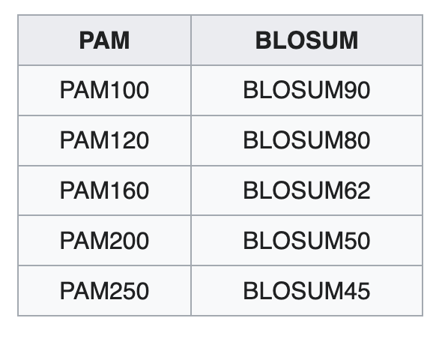
PAM vs BLOSUM
🔢 One can roughly relate the matrices one to another

Slide 27
How about gaps?
Matrix | Gap Opening (g_o) | Gap Extension (g_e)
PAM250 | –10 to –12 | –1 to –2
BLOSUM62 | –11 to –12 | –1 to –2
BLOSUM80 | –12 | –1
📊 To score the sequence alignment one has to introduce the gap penalty.
📊 There is no correct gap penalty, one has to choose some value.

Slide 28
Protein similarity
Feature | Typical Range | Interpretation
🧬 Sequence identity (%) | >30% | Likely homologous, functionally related
 | 20–30% | Twilight zone: possible distant homology, needs additional evidence
 | <20% | Usually unrelated sequences
📏 Alignment coverage (%) | >70% | Confident similarity when combined with identity
 | <70% | Short alignment; high identity may be misleading
💻 Bit score (BLOSUM62/PAM250) | >50 | Significant similarity
 | 30–50 | Borderline; may indicate weak homology
 | <30 | Weak evidence; likely random similarity

Slide 29
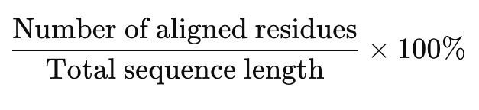
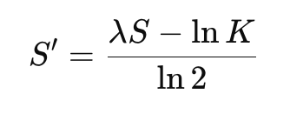
Protein similarity
The fraction of positions in an alignment where the residues are exactly the same.
🧬 Sequence identity (%)
📏 Alignment coverage (%)
💻 Bit score

Slide 30

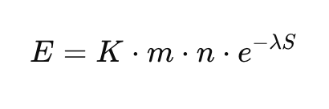
Statistical significance and E-value
🧮 E-value = expected number of random hits with score ≥ S
🔻 Lower E = higher significance
📏 Typical values: high significance E≤0.01
❓ Difference from p-value: E-value scales with database size

Slide 31
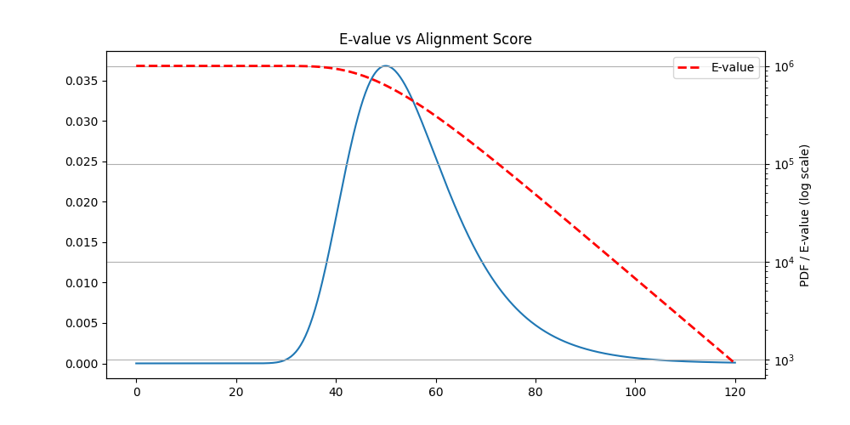
Statistical significance and E-value

Slide 32
Score normalization
⚖️ Raw scores depend on matrix and sequence length
🧮 Bit score = normalized, database-independent measure
📊 Allows comparison across searches and databases
📉 Higher alignment score → lower E-value

Slide 33
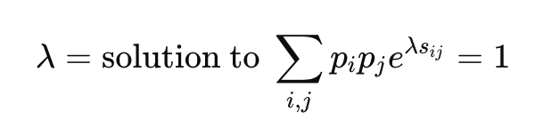
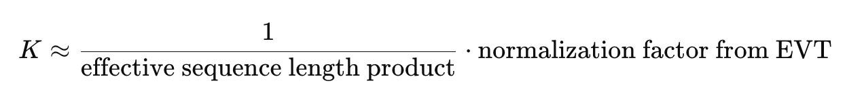
K and λ
⚙️ Intuition: λ “rescales” the scoring system so that high scores have predictable probabilities.
⚖️ Intuition: Accounts for the number of possible high-scoring alignments. Larger databases → higher K → higher E-values for same score.

Slide 34
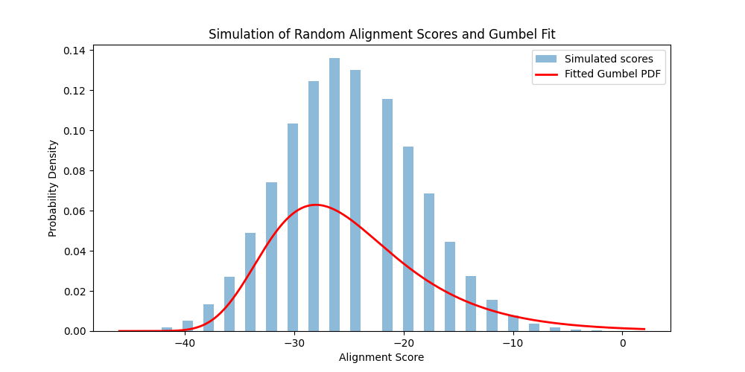
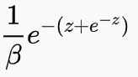
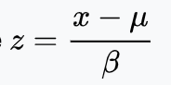
K and λ
lambda_est = 1 / beta
K_est = np.exp(-lambda_est * mu)

Slide 35
BLAST - motivation
⚡ Rapid identification of homologous sequences in large databases
🧬 Core idea: find high-scoring segment pairs (HSPs) using heuristics
🧪 Applications: gene annotation, functional inference, evolutionary studies

Slide 36
BLAST - workflow
🔹 Seed words (k-mers) from query sequence
🔍 Word matching against database
➕ Extend hits to High-scoring Segment Pairs
🧮 Compute raw score → bit score → E-value
✅ Filter and report significant hits

Slide 37
BLAST - variants
🧬 blastn: DNA/DNA comparison
🧪 blastp: Protein/Protein comparison
🔄 blastx: Translate DNA → Protein comparison
📏 tblastn: Protein vs translated DNA
🟢 tblastx: Translated DNA vs translated DNA
⚡ FoldSeek: Protein structure comparison

Slide 38

Foldseek
🧩 Rapid comparison of protein structures
🔤 Encode 3D structure into 1D structural alphabet
⚡ Perform fast sequence-like alignment
🧮 Compute alignment score → E-value
✅ Detect remote homology based on structure

Slide 39
Homology search pipeline -
🧬 Start with unknown sequence (gene/protein)
📚 Choose database (GenBank, UniProt, PDB)
⚡ Run search tool (BLAST/PSI-BLAST/FoldSeek)
📊 Retrieve top hits (E < threshold)
✅ Filter hits by coverage and identity
🧪 Annotate function or evolutionary relationship

Slide 40
Pitfalls
📏 High identity on a small fragment does not imply full homology
📚 E-values scale with database size
🔍 Assess coverage of query sequence
❗ Smaller database → smaller E-value for same alignment

Slide 41
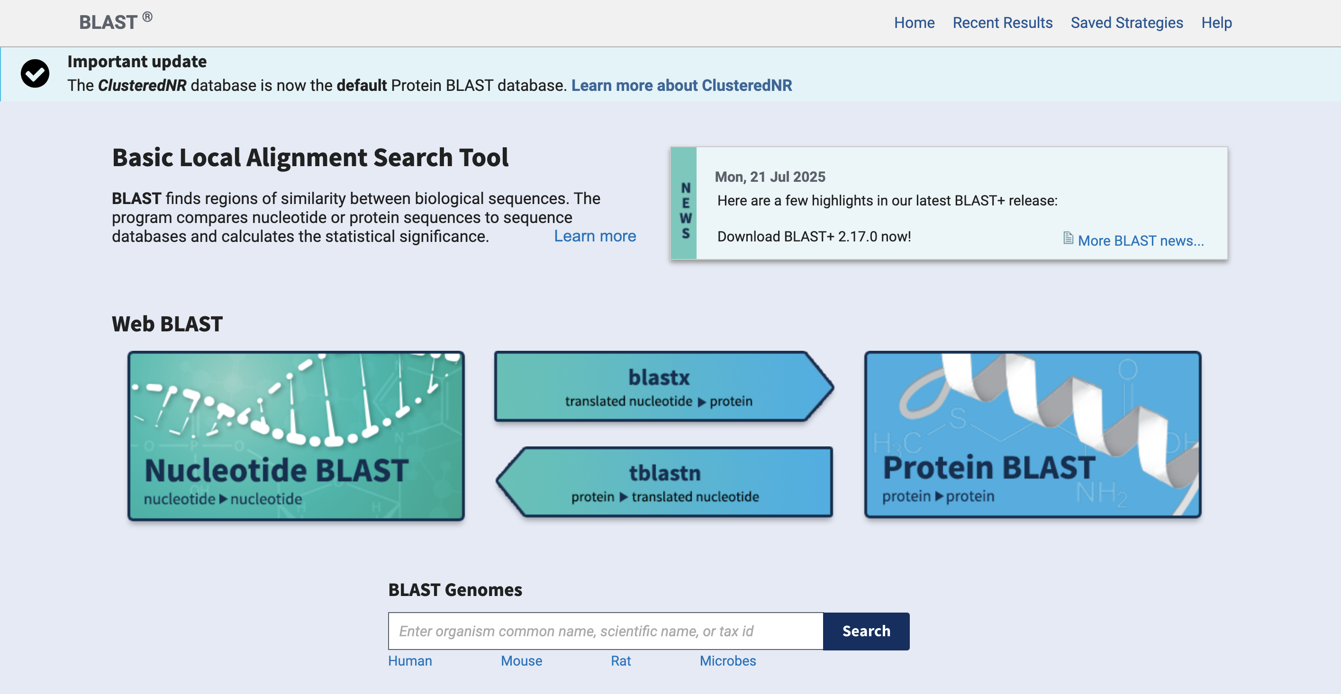

BLAST
Sześcian

Slide 42
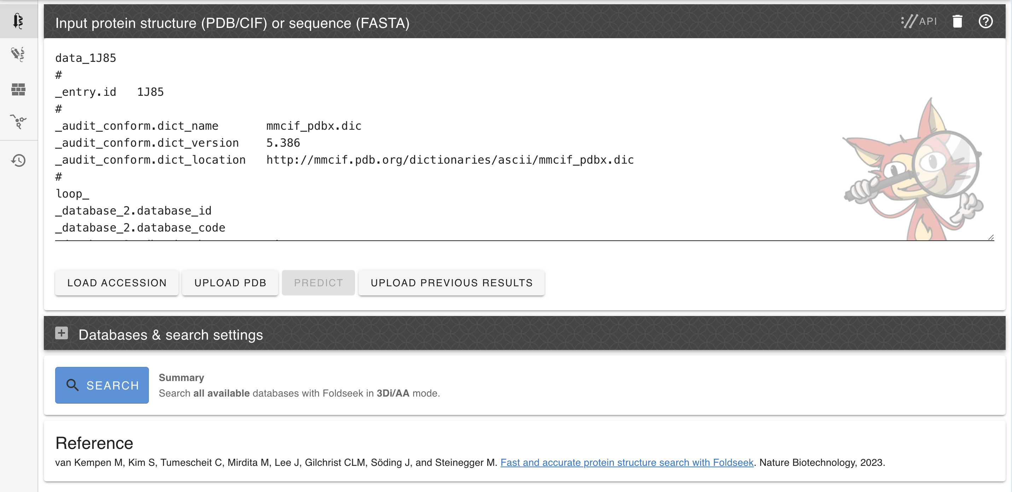
FOLDSEEK
Sześcian

Slide 43





Wrap-Up
🎯 Pairwise alignment: Needleman–Wunsch (global), Smith–Waterman (local)
📊 Substitution matrices: PAM, BLOSUM; log-odds scoring
⚡ Homology search tools: BLAST, PSI-BLAST, FoldSeek; E-value and bit score
✅ Pipeline: unknown sequence→ search → retrieve hits → filter → annotate

